Slide 1
Identifying and monitoring AI production models for negative feedback loops.
A presentation by Gleb V, CodeClan D4 student

Slide 2

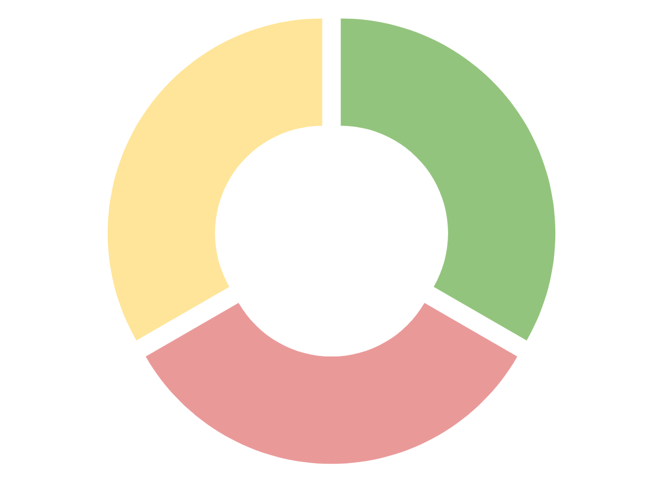
Feedback Loop
Data Collection
Data Preparation
Setting goals
Notes:
Attempt an explanation of what is a feedback loop based on this graphic.

Slide 3

Setting goals
Goal setting reflects business objectives.
AI will show bias based on pre-programmed parameters.
Notes:
AI models are not biased in itself, but bias is introduced by those who program and feed data into the models (intentionally and/or unintentionally)
Models are tools that we create and they continue the patterns that we show them.

Slide 4
Data Collection
50
75
Production
50
25
Notes:
Training data is evenly distributed 50/50 (no bias)
We told the algorithm to look out for fraudulent transactions.
Algorithm works really well, but we decide to retrain it.
We use our own data and end up with a much more strict model, because out model looks at much higher proportion of non-fraudulent transactions.

Slide 5
Data Preparation
Risk scale
0
100
50
Notes:
We could manually allow fraudulent transactions to go trough by manually overriding some of the AI decisions.
We could program our model to let let ambiguous risk through.
More regulation of the industry? Possibility of stalling the innovation.
Sandboxing? It would enable technological and regulatory development at the same time, but... Is it ethical?

Slide 6
It is up to us to ensure that what we create is fair and unbiased.
Questions
We need to monitor our creations to ensure optimal operation.
Regulation could be introduced to ensure fairness.

Slide 7
Following resources were used in preparation of this presentation:
Algorithmic bias detection and mitigation: Best practices and policies to reduce consumer harms. By Nicol Turner Lee, Paul Resnick, and Genie Barton. Published on 2019-05-22. Accessed on 2020-07-18
Managing Bias in AI. By Drew Roselli, Jeanna Matthews and Nisha Talagala. Published 2019. Accessed on 2020-07-18.
What is AI bias? By Cassie Kozyrkov. Published on 2019-01-24. Accessed on 2020-07-18.
Getting Better at Machine Learning. By Robert Chang. Published on 2018-09-26. Accessed on 2020-07-18.
Artificial intelligence is evolving all by itself. By By Edd Gent. Published on 2020-04-13. Accessed on 2020-07-18.

